Slide 1
Lesson 6 Part 2
A COLLECTION OR FIELD GUIDE:
CAUSE AND EFFECT

Slide 2
CAUSE AND EFFECT
Events have causes. We can think of nature as a world full of mysteries, or “effects,” and try to explain what might have caused what we see. Cause and effect relationships may be used to predict events.
In scientific practice, deducing the cause of an effect is often difficult, so multiple hypotheses may coexist. (Think about the different hypotheses about the extinction of dinosaurs – a meteor, climate change, starvation and more.)
Cause and Effect can be answered with COULD IT BE… hypotheses.

Slide 3
How to Study Cause and Effect
As yourself these questions when you are doing an observation:
What happened here?
What caused this to happen?
How might you explain that?
What are other possible explanations?
Why is it like that?
What would happen if…?
How does this affect other things?

Slide 4
Examples of Evidence of Cause and Effect
Things impacted or shaped by water
Signs of fall
Things affected by wind
Things that snow does
Shapes of icicles
Evidence of drought
Things that are broken
Things that are soft
Things with strong odor
Things attracted to porch lights at night
Signs of the season

Slide 5
Your Turn
Make a field guide of your chosen subject that shows CAUSE AND EFFECT.
Include three to five things in your field guide.
Arrange the page so that you show a drawing with words and numbers next to it.
Record observations with words, pictures, and numbers, paying attention to similarities and differences and evidence of CAUSE AND EFFECT.

Slide 6
Remember to begin with your metadata
Date, Day, Time
Location, habitat
Weather
Temperature
Wind
% Cloud cover

Slide 7
Plan your page
Heading first
Then Title
If you’re studying three objects, create enough space for all three things.
(Consider using two pages.)
Remember to include ABC’s, 123’s and drawing/sketch/diagram.
Use the next page for your reflection questions/paragraph.

Slide 8
One Additional Thing:
For each “I wonder…”
Write one or two hypotheses by completing the sentence frame:
“Could it be…”

Slide 9
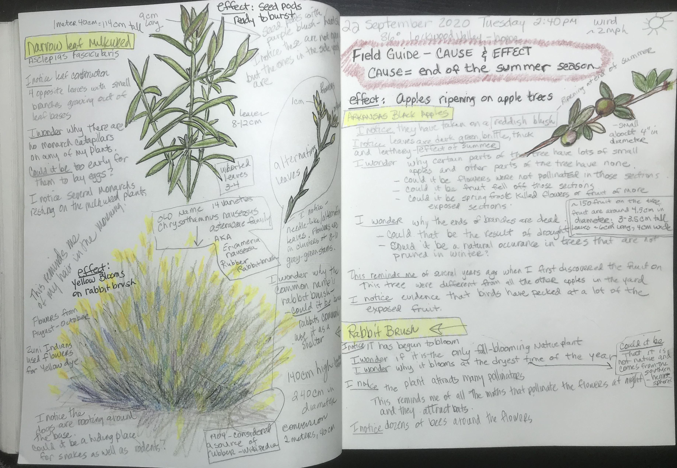
Plan your layout the way you want it.
Here’s mine:
3 sections using both pages
Lots of measurements (123’s)
Each subject treated the same way
Name of plant
Measurements
I notice, I wonder, this reminds me of
COULD IT BE… for each “I wonder”

Slide 11
Notice:
*Metadata
*Title - I even gave the cause a name: “end of the summer season”
*I mentioned the effect of the cause then began my journal study
Because I wrote more about the apple than I had planned, I began to study Rabbit Brush under it, thinking I would do a smaller drawing, but again, ran out of room, so…

Slide 12
I moved over to the opposite page and continued to draw the rabbit brush and write more things at the bottom, directly across from where I started. Then I did my third study (milkweed) above it. So I sort of created my page in a clock-wise circle.

Slide 13
Now do your own field guide. Focus on CAUSE AND EFFECT
Take 45 minutes to 1 hour to work on all your studies (3-5).
Come back and do your reflection questions on your next page.

Slide 14
REFLECTION
Question/Answer
Question/Answer form (Put as many words from the question into your answer.)
Answer
Answer all questions, then put them in an order that makes sense for a paragraph.
Begin
Begin with a topic sentence (“I created a field guide focusing on CAUSE AND EFFECT.”)
End
End with a closing sentence (“It was interesting to hypothesize about the causes and effects of my subjects.”)

Slide 15
REFLECTION QUESTIONS
What are some features that all of the things you studied share?
How might you describe this category of things in general?
What were some of the differences between the subjects in your field guide?
What are some possible explanations for why these features occur? (These are the “COULD IT BE…” statements.)
(You need to include AT LEAST two hypotheses. The more you include, the more you’re thinking like a scientist!)
If you made a field guide to evidence an effect, what can you say about how that effect is impacting this place? (For example, if you did it on evidence of drought, how is drought impacting the habitat?)

Slide 16
Looking Forward
Next time, we’ll create a field guide focused on Systems and System Models.
Start looking around for interesting subjects.

Slide 17
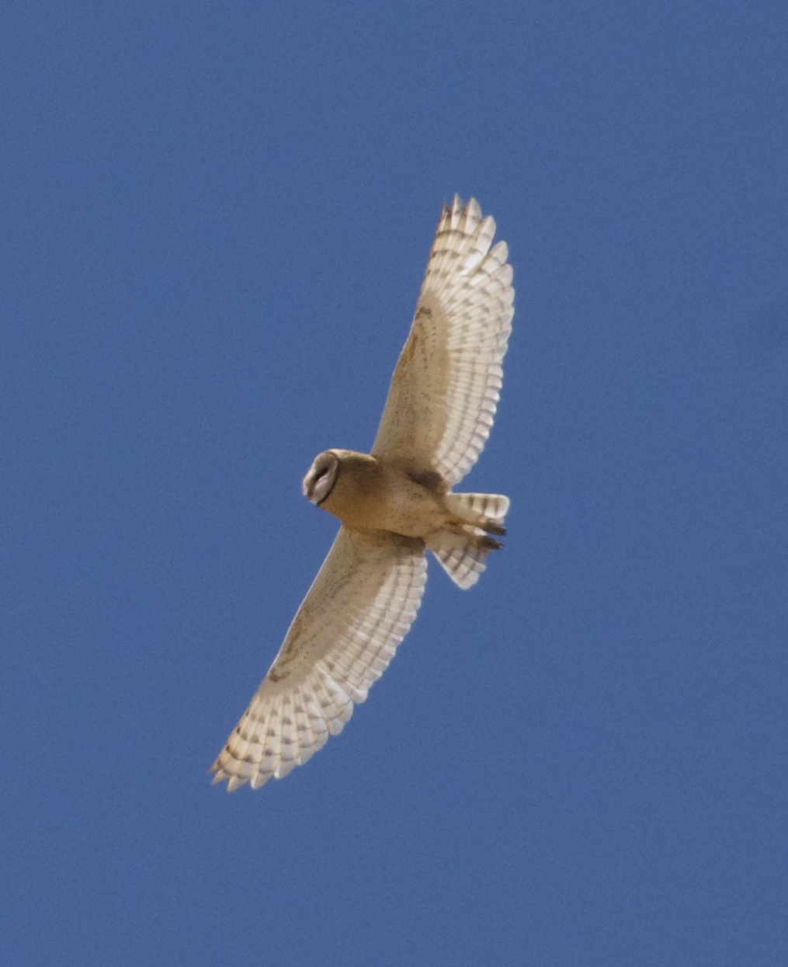
BYE FOR NOW. THANKS FOR JOINING ME.

